Slide 1
Separately excited generator on no load
Curve shows variation of the open-circuit voltage across the armature with the field current at a given speed.
The curve is called the open-circuit characteristic(O.C.C.).
The open-circuit curve for other dc machines is obtained by separately exciting the machine and driving the rotor by a prime mover.
The curve is shown on the next slide

Slide 2
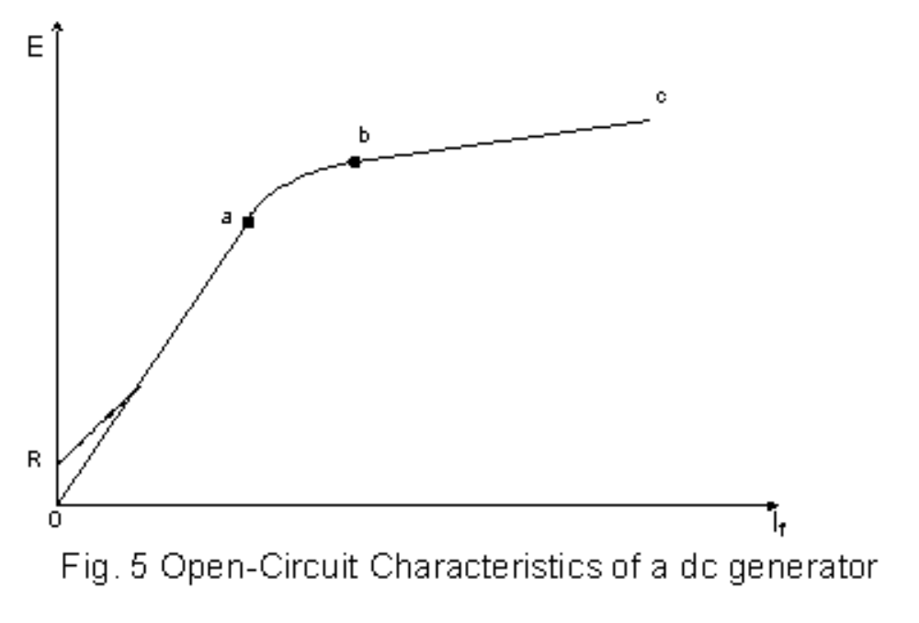
Separately excited generator on no load

Slide 3
Separately excited generator on no load
Since the o/c Voltage E is proportional to phi (φ) at a given speed, the curve also shows how the flux varies with the field current.
For this reason the curve is also referred to as the magnetization curve.

Slide 4
Separately excited generator on no load
The curve has three portions:
A linear portion oa,
The portion ab called the knee of the O.C. curve (in this portion the saturation of the iron begins to be important) and
The saturated portion bc ( here, a large increase in the field current results in a small increase in flux)

Slide 5
The rated voltage of a dc generator is usually a little above the knee of the curve if the curve is obtained at the rated speed.
If the machine has been used before and it is not demagnetised, the emf curve is found to follow the dotted line
oR represents the emf generated by residual magnetism in the poles.
At a given field current the generated voltage E is proportional to the speed N.

Slide 6
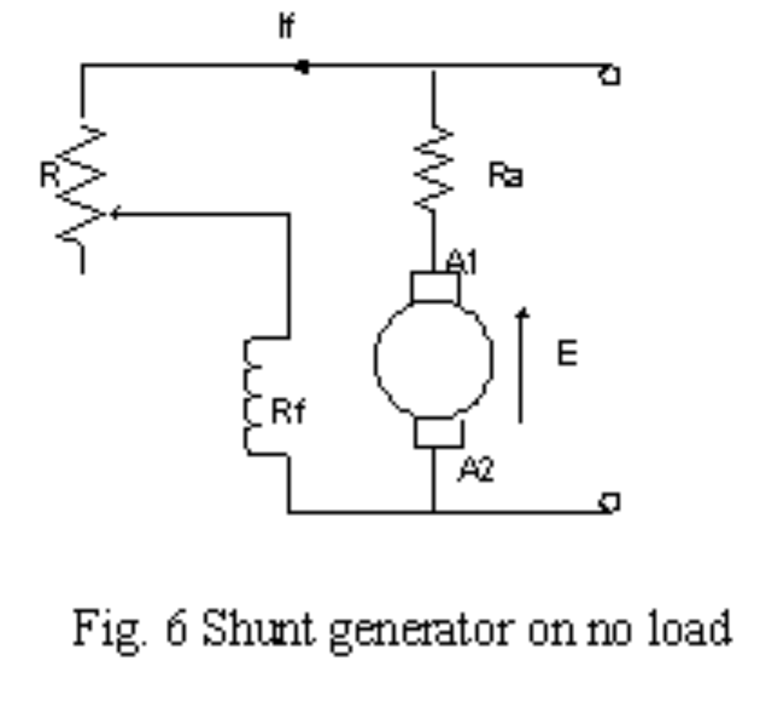
Shunt generator on no load
  The circuit is shown below

Slide 7
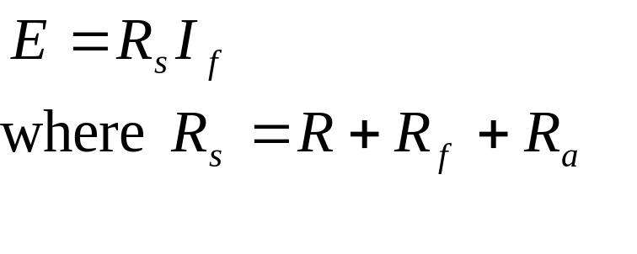
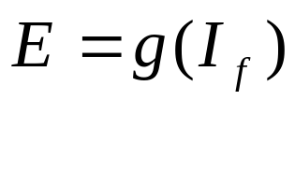
Shunt generator on no load Cont’d
  By Ohm’s law or KVL
  We also know that at a given speed,
  This the nonlinear function given by the magnetization curve.
  The values of E and I_{f} are determined by the intersection of the curves described by the two equations

Slide 8
Shunt generator on no load cont’d
  Steady state value of E and I_{f} are reached after a transient build–up process (This explained on the next slide)
  At the rated (or a given speed), the voltage across the armature due to residual magnetism is E₁.
  But this voltage is also across R_{s}. Thus, the current which flows in the field circuit is I₁

Slide 9
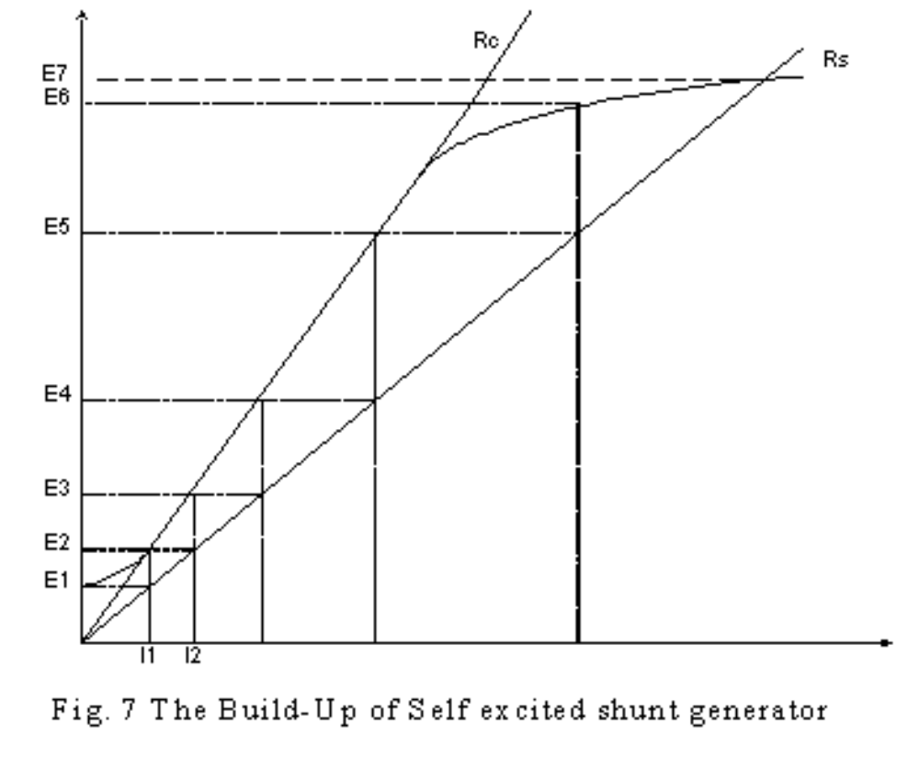
Shunt generator on no load cont’d

Slide 10
Shunt generator on no load cont’d
When I₁ flows in the circuit of the generator, an increase in mmf results which aids the residual magnetism in increasing the induced voltage to E₂
Voltage E₂ is now impressed across R_{s} causing a larger current I₂ to flow in the field circuit.
An increased mmf due to I₂ produces generated voltage E₃

Slide 11
Shunt generator on no load cont’d
The process continues until that point where the shunt resistance line crosses the magnetization curve. Here the process stops.
Why?
Because the voltage induced, when impressed across R_{s}, produces a current flow that in turn produces an induced voltage of the same magnitude E₇

Slide 12
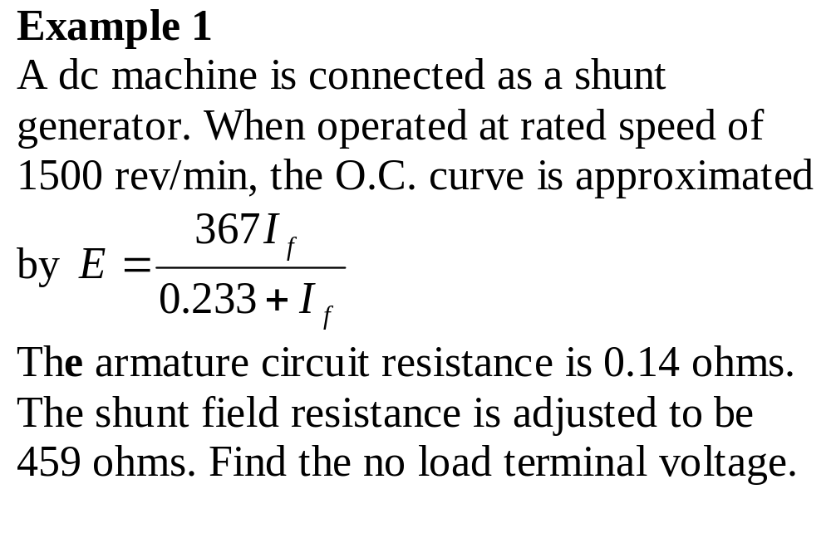

Slide 13
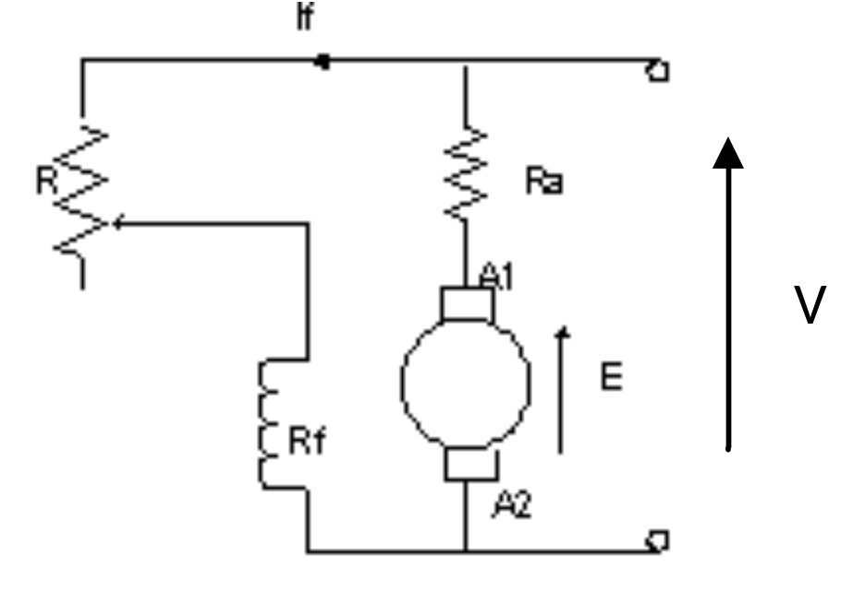
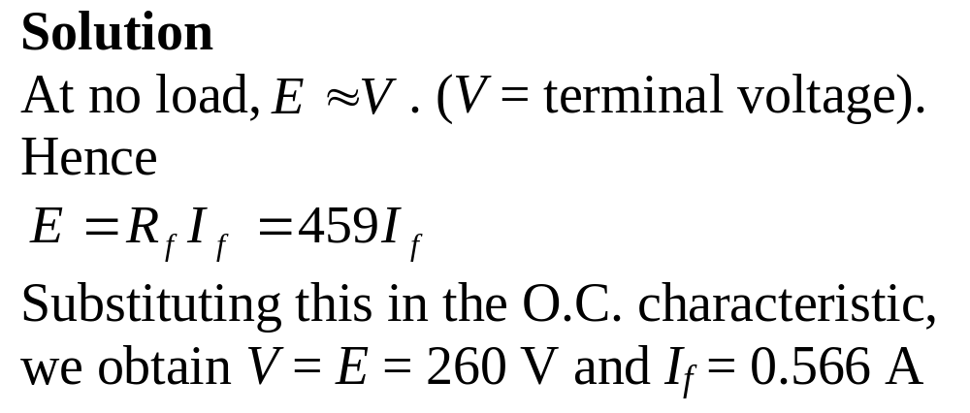

Slide 14
Critical field circuit resistance
It is the field circuit resistance beyond which the shunt generator will fail to excite.
The critical field circuit resistance, R_{c}, is shown as a tangent to the O.C. Curve passing through the origin , i.e.,
it is the slope of the tangent to the O.C. curve passing through the origin.
This resistance is proportional to the speed.

Slide 15
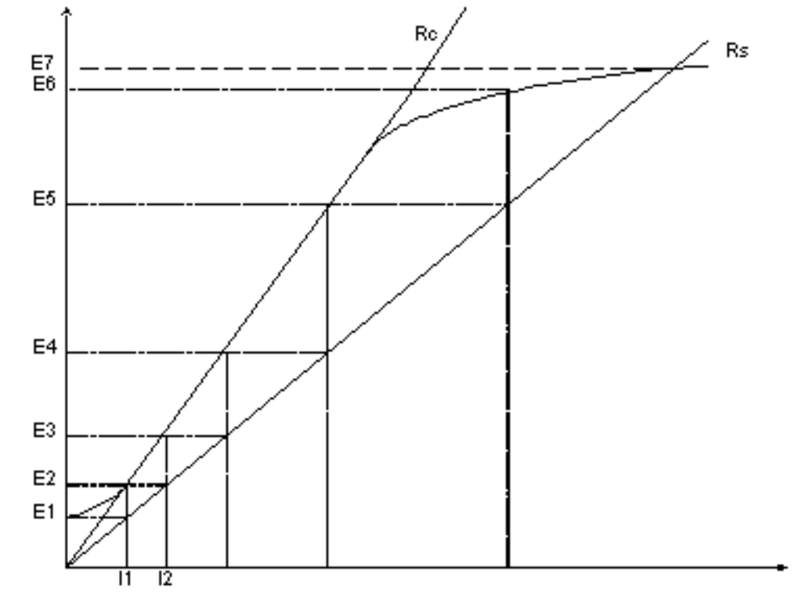
Critical field circuit resistance cont’d

Slide 16
4 reasons why shunt generator will fail to self-excite (or build up voltage)
(1) Lack of residual magnetism
Causes
Residual magnetism may be lost as a result of
mechanical shock in shipment,
excessive vibration,
extreme heat and
inactivity for long periods.

Slide 17
(1) Lack of residual magnetism Cont’d
Remedy
Separately excite the field for a few
moments.
Where possible, run the machine as a
motor; its brushes being of the normal
polarity and the direction of rotation also
normal (a better method).

Slide 18
(2) Field circuit connections reversed with respect to the armature circuit.
Remedy
Change over connections from the armature to
the field circuit.
(3) Direction of rotation reversed
This also produces reversed armature connections with respect to the field.
Remedy
Turn it in the right direction.

Slide 19
(4) Field circuit resistance higher than critical field resistance
Causes
They are
broken lead in any part of the field circuit,
too high a brush contact resistance (very rare)
and
too large a resistance in the field regulator for
the particular speed operation.

Slide 20
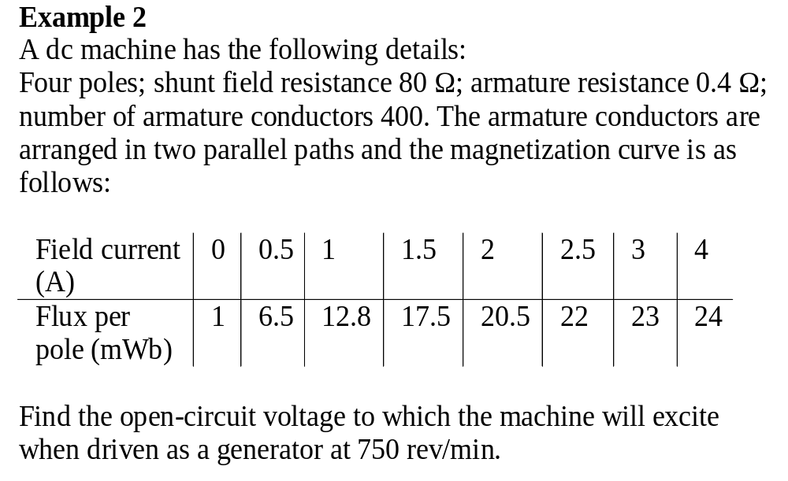

Slide 21
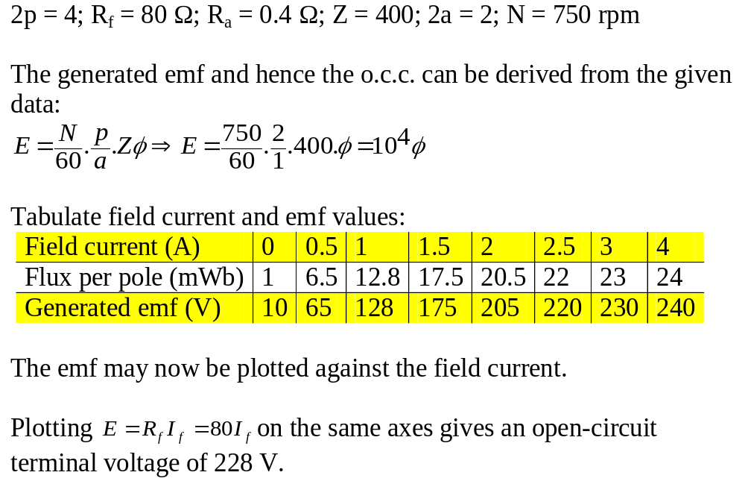

Slide 22
Load (or External) Characteristics of DC Generator
The external characteristic shows
the variation of the terminal voltage with the load current at a given speed
(usually the rated speed).

Slide 23
Load (or External) Characteristics of DC Generator Cont’d
When a generator is supplying power to a load
the voltage-current curve of the load
and
the load curve of the generator
can be plotted on the same graph to obtain the point of steady state operation.
The point of steady state operation given by the point of intersection of the two curves.

Slide 24
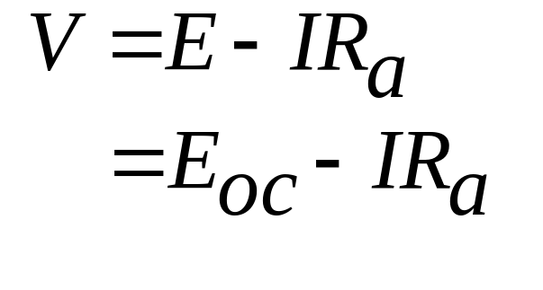
Load Characteristics of D.C. Generator Cont’d
Separately-excited generator
The curve is obtained keeping
  - the field current I_{f} constant and
  - the speed constant.
Referring to the circuit on the next slide, the terminal voltage is given by

Slide 25
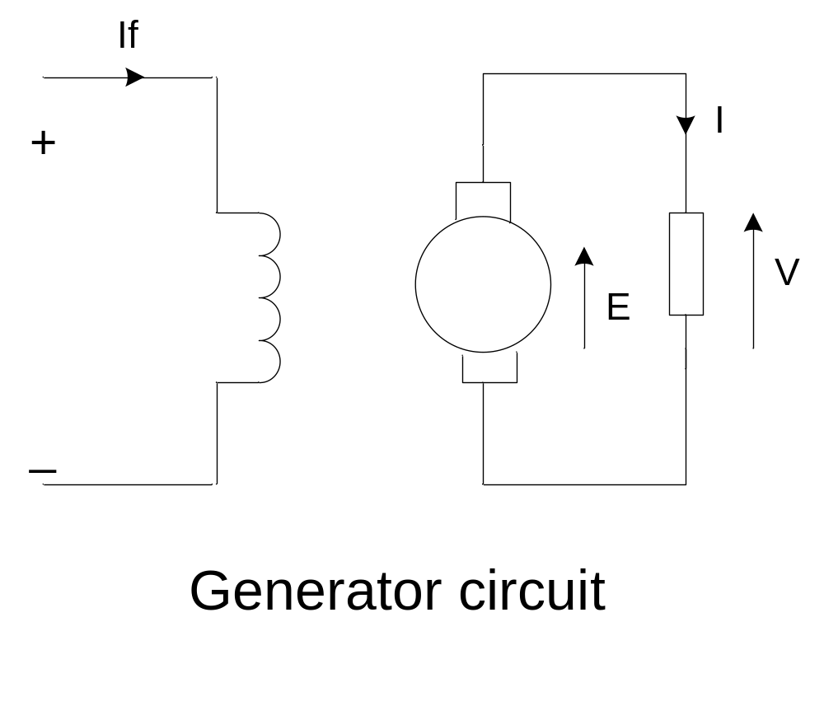
Separately-excited generator Cont’d
E_{oc} = open circuit emf is constant (i.e. it does
not change when the load changes)
R_{a} = total resistance in the armature circuit.

Slide 26
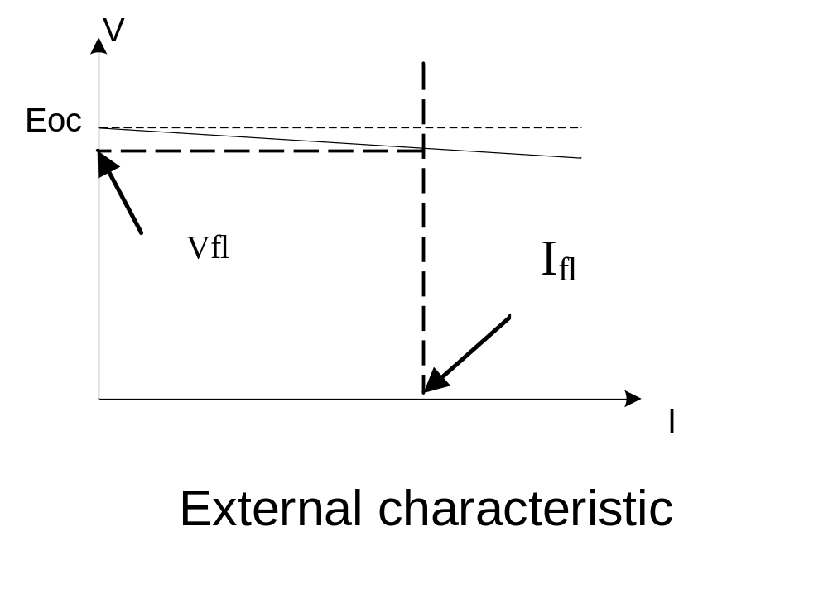
Separately-excited generator cont’d
Voltage drop from no load to full load is usually less than 10 %

